Slide 1
Campaign Funnel Classification
A weak-supervision labeling pipeline + traffic correlation analysis
Part 1 — Label every campaign as top- or bottom-funnel
Part 2 — Correlate funnel strategy with website traffic
ds-assignment-1

Slide 2
BACKGROUND
The Problem
▪ An agency runs ad campaigns for many clients
  – Across Google Ads, Meta, TikTok and LinkedIn
▪ Every campaign has a funnel level
  – Top-funnel — reach new people, build awareness
  – Bottom-funnel — convert warm, high-intent audiences
▪ But clients never labeled this
  – There is no reliable funnel_level field in the data
  – Some campaign names hint at it, many do not
▪ Goal: produce a funnel label for every campaign
Why it matters
Top- and bottom-funnel campaigns are:
• optimised differently
• budgeted differently
• reported differently
Without the label, performance cannot be analysed fairly.
2

Slide 3
METHOD
Approach: A Two-Stage Pipeline
The catch: zero labels to start with — and a model cannot train without labeled examples.
STAGE A — Heuristic labels
STAGE B — Trained classifier
No model. Use rules to label the
campaigns we are confident about.
Each label gets a confidence tier.
Train a model on the confident
labels, then predict the funnel
level for ALL 637 campaigns.
This pattern — generating labels with rules, then training on them — is called weak supervision.
3

Slide 4
EXPLORATION
The Dataset
4,546
637
120
4
monthly rows
campaigns
customers
ad platforms
▪ One row per campaign per active month — over a 12-month period
  – Config fields (audience, objective, format) stay constant; only metrics vary
  – So the data must be aggregated to campaign level before modelling
▪ Numeric metrics are heavily skewed — a log scale is needed to see them
▪ A missing ROAS value is not random
  – It means the campaign never tracked conversion value — itself a funnel signal
4

Slide 5
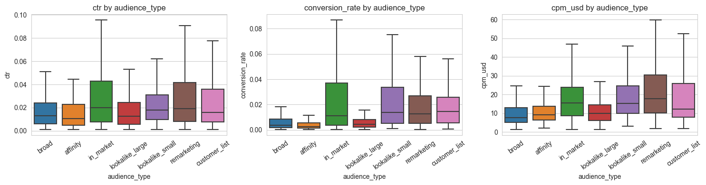
EXPLORATION
EDA: Strong, Separable Signals
▪ Warm audiences (remarketing, customer list) show higher conversion rates
▪ Broad / affinity audiences behave like classic top-funnel reach
▪ The funnel signal is visible directly in the raw metrics
Click-through rate, conversion rate and CPM by audience type
5

Slide 6
STAGE A
Stage A: Five Independent Signals
Each signal independently votes top or bottom. A majority vote sets the label.
Audience type
remarketing → bottom • broad / affinity → top
Objective
“awareness / reach” → top • “conversion / sales” → bottom
Optimization event
impressions / views → top • purchase / lead → bottom
Ad format
video → top • lead form / dynamic product ad → bottom
Campaign name
keyword match: “prospecting / launch” vs “retarget / branded”
Confidence tier (high / medium / low) is set by HOW MANY signals agree.
6

Slide 7
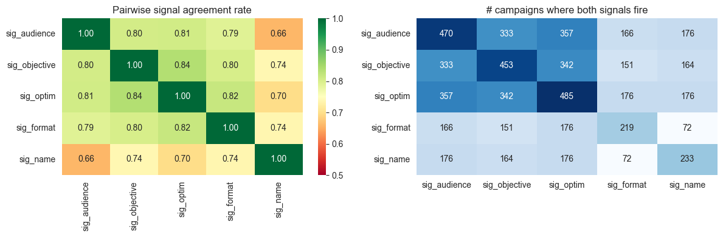
STAGE A
Stage A: How Do I Trust the Labels?
▪ The signals are independent — so they can check each other
  – Pairwise agreement: when two signals both fire, how often do they match?
▪ Agreement is consistently high → the heuristic is well-calibrated
Left: pairwise signal agreement rate | Right: overlap count
7

Slide 8
STAGE A
Stage A: Results
▪ High confidence — 53% (3+ signals all agree)
▪ Medium confidence — 32% (clear majority)
▪ Low confidence — 7% (single signal / conflict)
▪ Unlabeled — 8% (no signal fired at all)
91.7%
of campaigns labeled
by rules alone
Key decision
Only HIGH + MEDIUM labels are used to train the model.
LOW + unlabeled campaigns become the model's prediction targets —
noisy labels are kept out of training.
8

Slide 9
STAGE B
Stage B: Feature Engineering
Three feature groups, built after aggregating each campaign to a single row.
NUMERIC
CATEGORICAL
TEXT
• log(spend), log(impressions)
• CTR, conversion rate, CPM, CPC
• daily budget, active months
• roas_tracked (0 / 1 flag)
• platform, objective
• bidding strategy
• optimization event
• ad format, audience type
• → one-hot encoded
• campaign_name
• → TF-IDF (1–2 grams)
• rare meaningful words
• get higher weight
9

Slide 10
STAGE B
Stage B: Model & Validation
▪ Two models compared
  – Logistic Regression — simple, fast, interpretable baseline
  – LightGBM — gradient-boosted trees, captures non-linear patterns
  – No deep learning — the dataset is too small; it would just overfit
▪ GroupKFold cross-validation, split by customer_id
  – One client names all their campaigns alike
  – Mixing a client across train and test would leak that style → inflated score
▪ Sample weights — high-confidence labels count more than medium ones
10

Slide 11
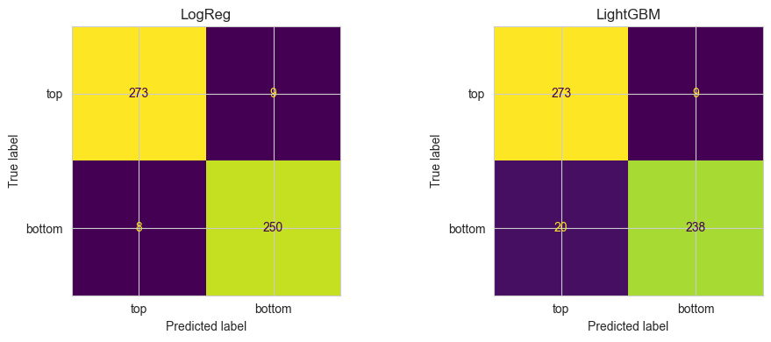
STAGE B
Stage B: Results
▪ Logistic Regression AUC 0.994 • LightGBM AUC 0.985
  – Picked Logistic Regression — slightly better and simpler to explain
▪ ~97% cross-validated accuracy → final labels: 321 top / 316 bottom
Confusion matrices from GroupKFold cross-validation (held-out customers)
11

Slide 12
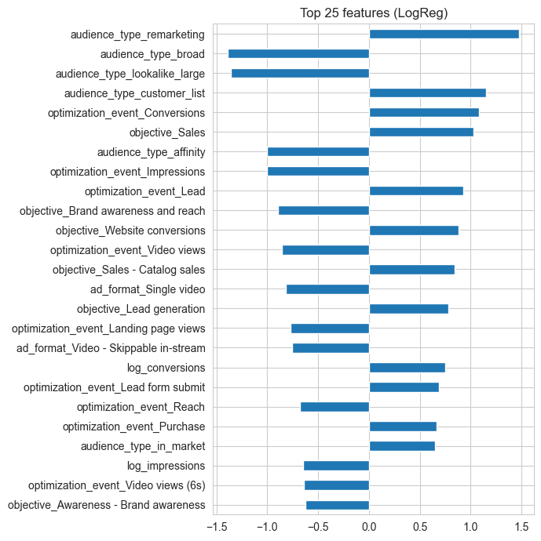
STAGE B
Stage B: What the Model Learned
▪ Top features match domain intuition
  – ROAS tracking, audience type and name keywords drive the prediction
▪ A sanity check: the model learned real logic, not noise
12

Slide 13
REFLECTION
Part 1: Validation & Reflection
▪ How much could Stage A label? — 91.7%, with confidence tiers measured
▪ Does the model generalise?
  – GroupKFold held out whole customers → the AUC is an honest estimate
  – Model agrees with Stage A on 97.6% of labels → consistent, not drifting
▪ Honest limitation
  – There is no independent ground truth — model is judged against rule labels
  – If the rules share a bias, the model learns it and evaluation misses it
▪ Next step: hand-label ~50 campaigns as a true, independent test set
13

Slide 14
PART 2
Part 2: The Question
Does a customer's mix of top- vs bottom-funnel activity leave a detectable fingerprint in how traffic arrives at their website?
▪ New dataset — traffic.csv
  – One row per customer per month, same 12-month period
  – Traffic source: branded / non-branded search, direct, social, email, referral
  – Traffic quality: new-visitor rate, bounce rate, pages/session, conversion rate
▪ Joined to the Part 1 labels via customer_id
14

Slide 15
PART 2
Part 2: Measuring Funnel Mix
Funnel mix = bottom-funnel spend ÷ total spend
▪ Why a SHARE, not raw spend?
  – Raw spend just measures customer size — big spenders would dominate
▪ Why SPEND, not campaign count?
  – Spend reflects real investment — a $5,000 and a $10 campaign are not equal
▪ Months with no campaigns
  – Funnel mix is genuinely undefined → those rows are dropped (3.9%)
  – Imputing 0 or 0.5 would invent a strategy that never existed
15

Slide 16
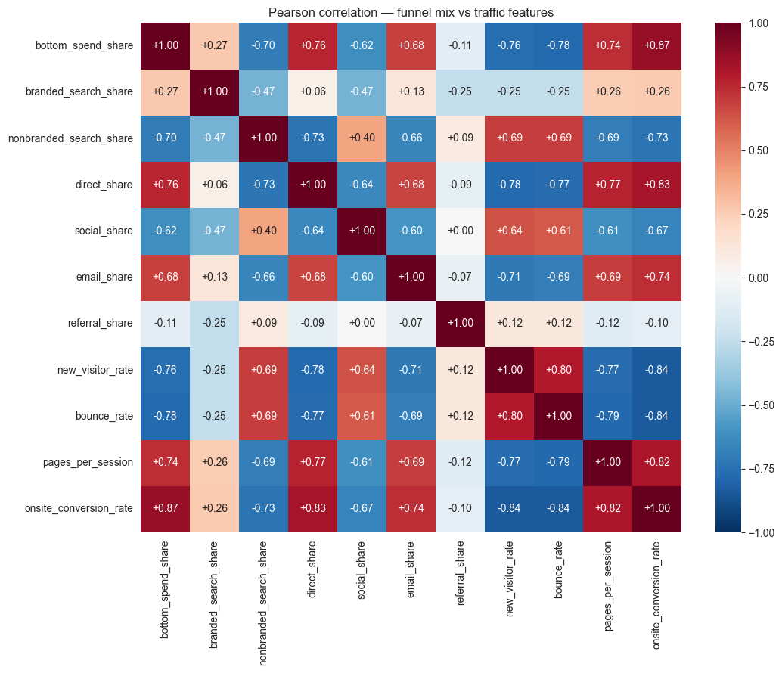
PART 2
Part 2: Funnel Strategy Shows Up in Traffic
▪ More bottom-funnel → higher conversion rate, more direct & branded traffic
▪ More top-funnel → more new visitors, higher bounce, more social & non-brand search
▪ Strong correlations — many above 0.7 in magnitude
16

Slide 17
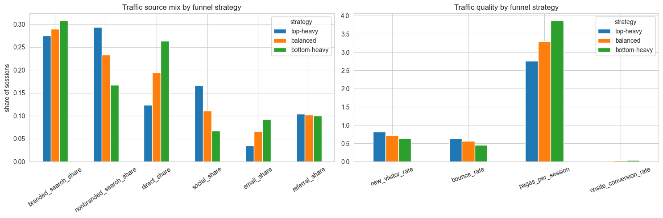
PART 2
Part 2: A Story for Stakeholders
▪ Customers grouped into top-heavy, balanced and bottom-heavy
  – Their typical traffic profiles are compared side by side
▪ One clear picture communicates the finding better than a correlation table
Traffic source mix and traffic quality by funnel strategy group
17

Slide 18
Conclusions & Next Steps
Delivered A two-stage weak-supervision pipeline labeled all 637 campaigns with a funnel level, a probability, and a confidence score.
Finding Funnel strategy leaves a clear fingerprint in website traffic — bottom-heavy customers convert better and rely on direct & branded traffic.
Limitation No independent ground truth; Part 1 labels are model predictions, so that error propagates into Part 2. Correlation is not causation.
Next steps Hand-label a real test set; re-run Part 2 using only high-confidence campaigns as a robustness check.
Thank you — questions welcome

